Slide 1
Margin & Padding
Marwin Palea

Slide 2
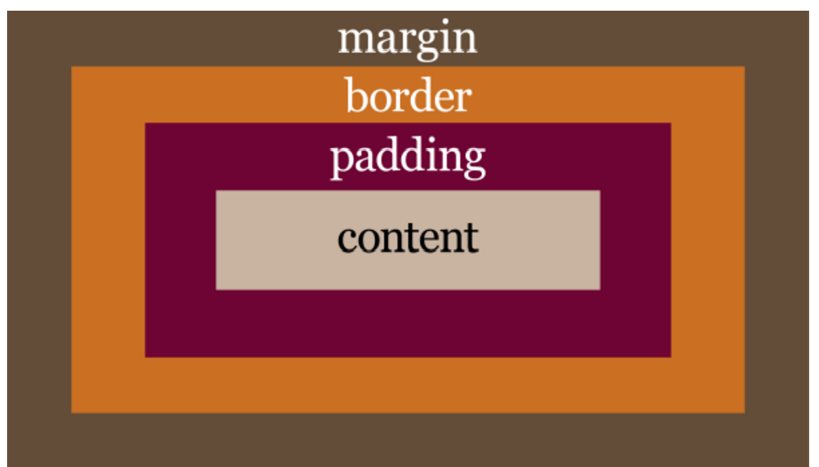
Box model

Slide 3
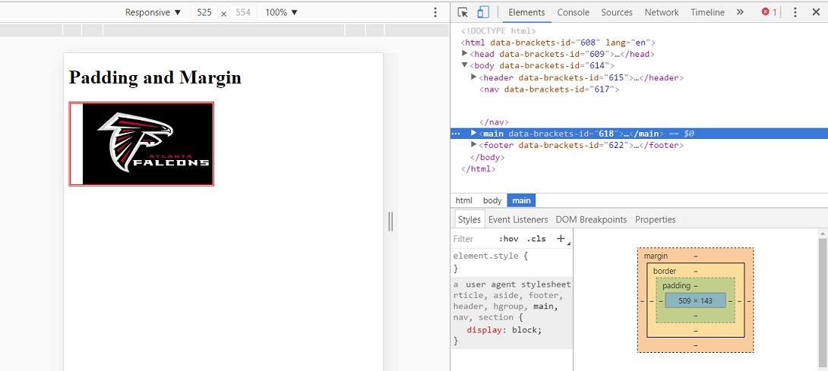

Slide 4
padding
The padding is the space around the content.
The css padding properties are used to generate space around content
The padding clears an area around the content (inside the border) of an element

Slide 5



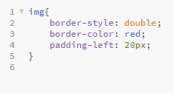
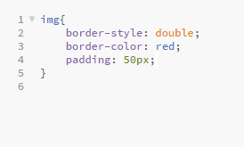
It can be defined for an individual side or all four

Slide 6
margin
Margins are similar to padding, and are defined using similar syntax
However, unlike padding, the margin portion of an element exists outside the element.
A margin creates space between the targeted element and surrounding elements.

Slide 7
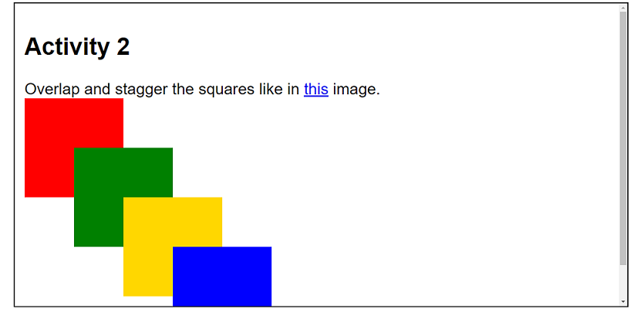
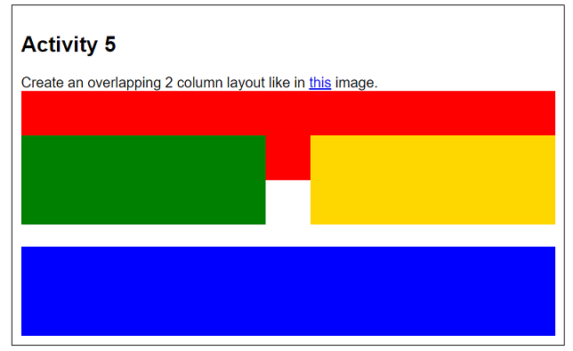
Margin can be used to separate elements, bring them together , or even overlap them.

Slide 8
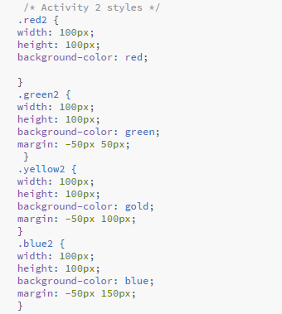
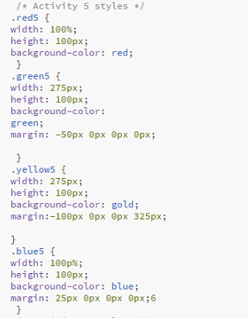

Slide 9

questions?

